Slide 1
COLUMBIA RIVER
GORGE NSA
Resort Market Case
Notes:
Columbia River Gorge National Scenic Area- established by President Regan in 1986. Established 292,500 acres of protection and enhancement of scenic, cultural, natural and recreation resources.

Slide 2
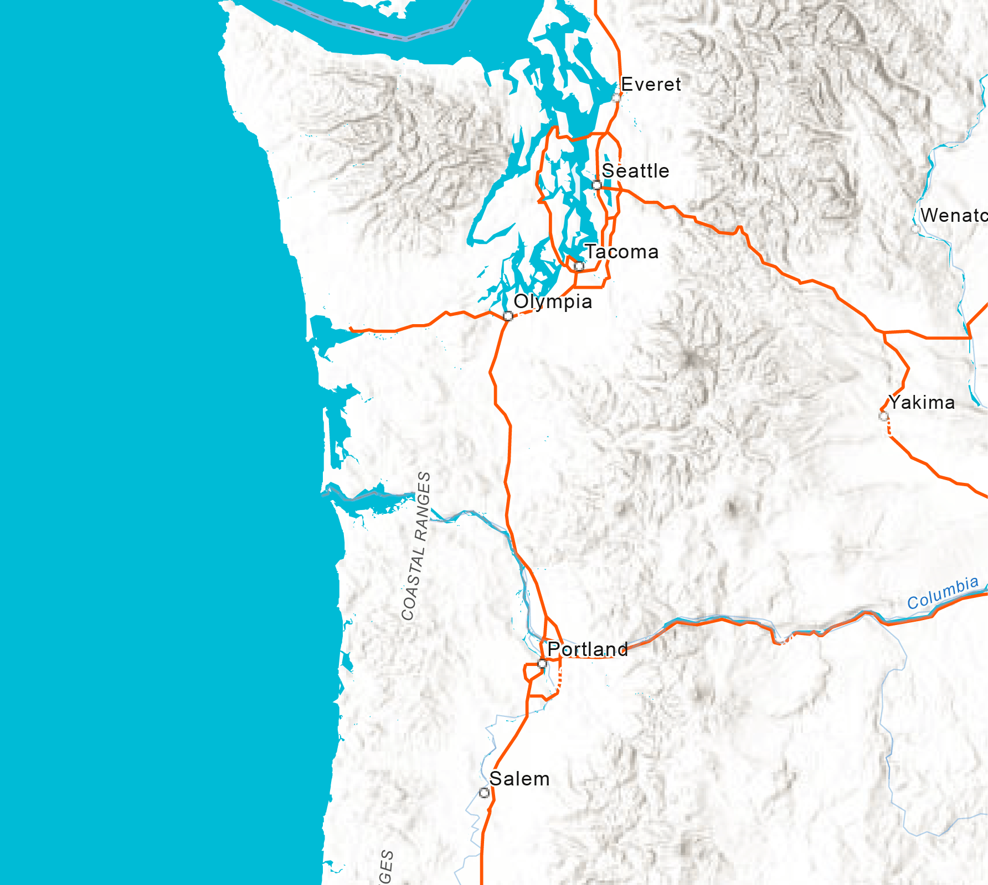
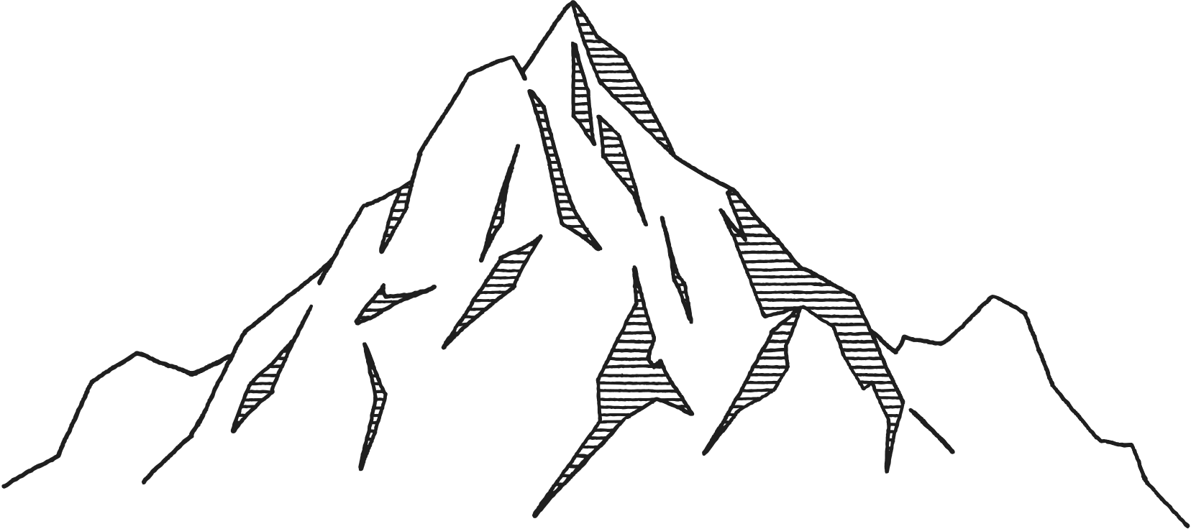
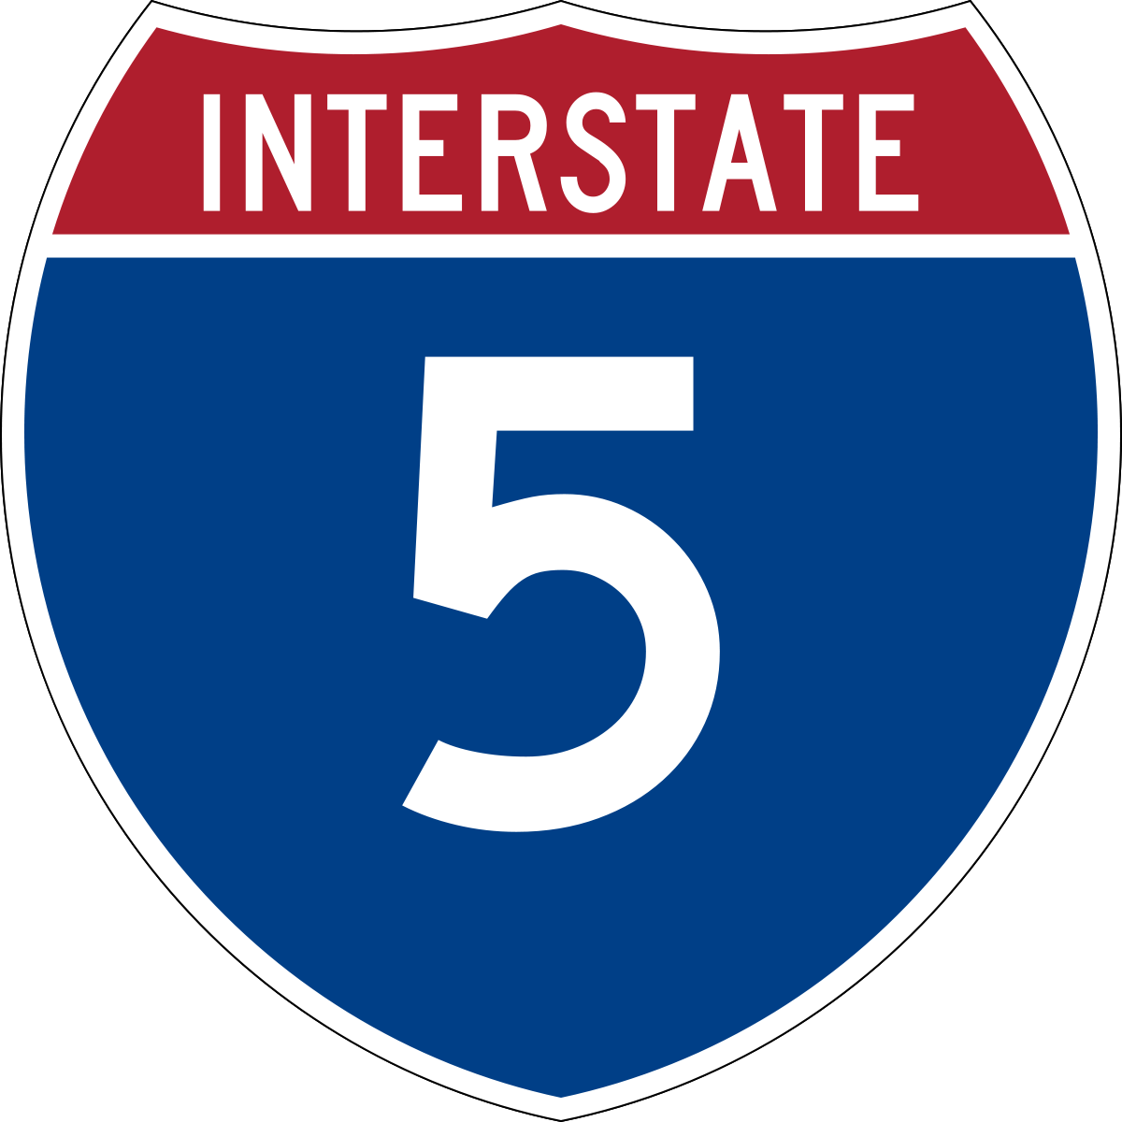
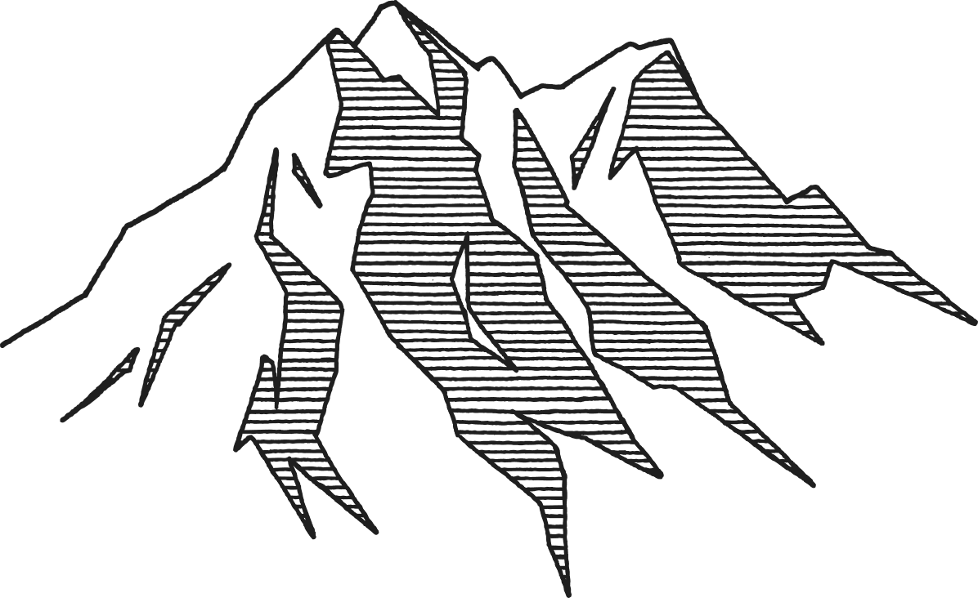
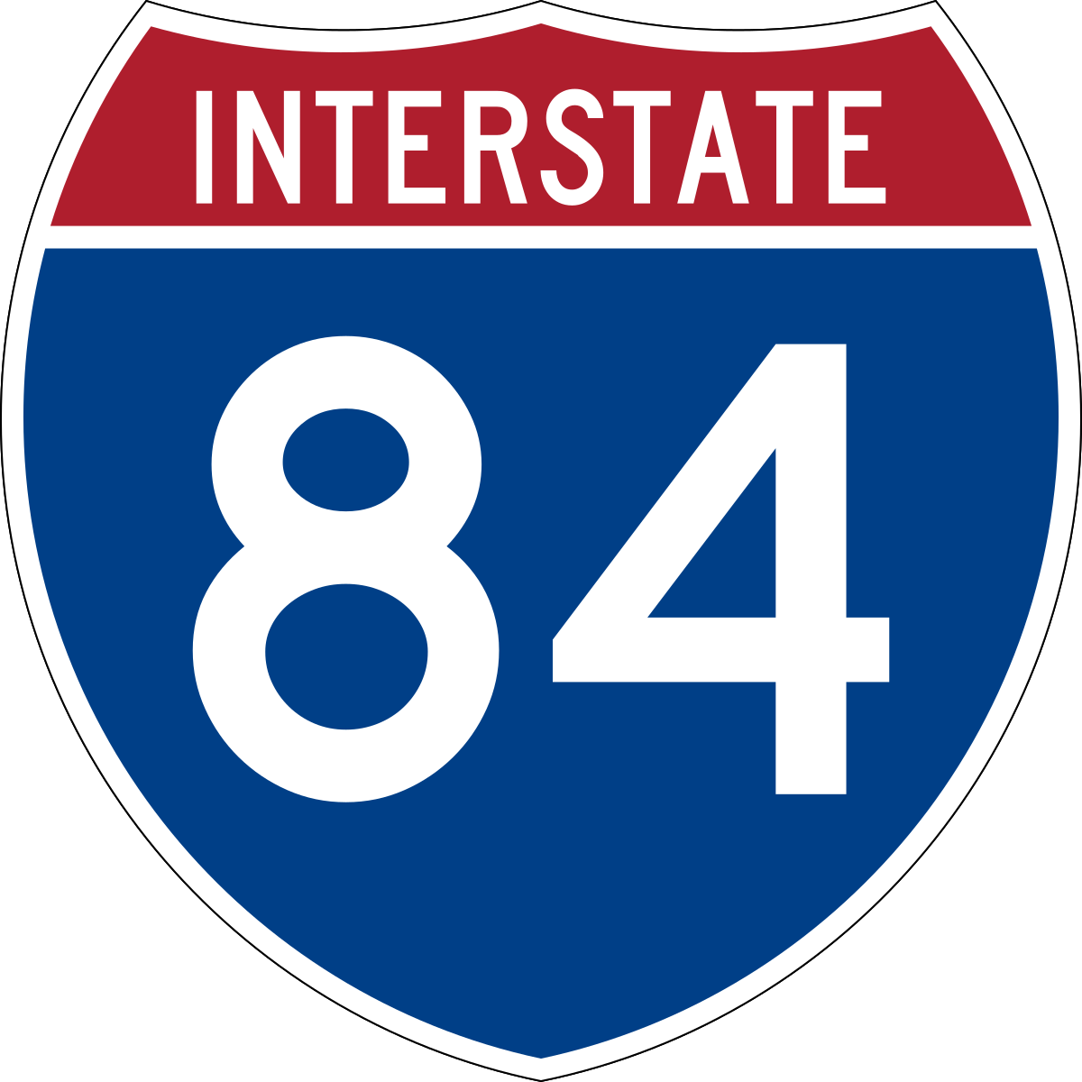
REGIONAL CONTEXT
3.5 hours from Seattle Metro
45 minutes from Portland Metro/PDX
Mt. Rainier
Mt. St. Helens
The Gorge
Mt. Hood
PDX
Notes:
Proximity to Portland metro and PDX and Seattle and SeaTac.
Also near other national parks and monument, Mt. Hood, St. Helens, Rainier and Gifford Pinchot National forest.

Slide 3
GORGE AREA TOURISM Quick Facts
3.3 million
annual overnight trips
$598 million
in annual spending
With $206 million on lodging
Notes:
Data from 2017 Travel Oregon Report conducted by Longwoods Travel USA, dollar amounts adjusted to 2022 USD
3.3 million annual overnight trips, 1.9 million are considered marketable (excludes visiting family, etc.)
Peak season- April to September 64% of trips

Slide 4
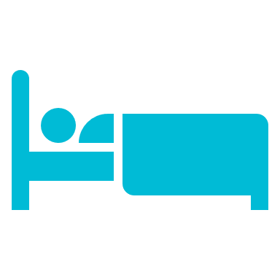
VISITOR / TRIP PROFILE
$79,975
average income of visitors
Spending Per Night Per Person
Lodging
2.0
Restaurant
Food &
Beverage
average nights spent
in the Gorge region
Transportation
at Destination
Recreation / Sightseeing / Entertainment
Retail Purchases
$54
$34
$19
$16
$15

Slide 5
VISITOR / TRIP PROFILE
Lodging
Retail Purchases
$46
$16
$14
$13
Notes:
Designated market area trip origin- large area surrounding each metro
Most trips from the Portland DMA
At a state level: 33% of trips originate from Oregon, 16% from Washington and 16% from California,
But also national draw with 5% from New York

Slide 6
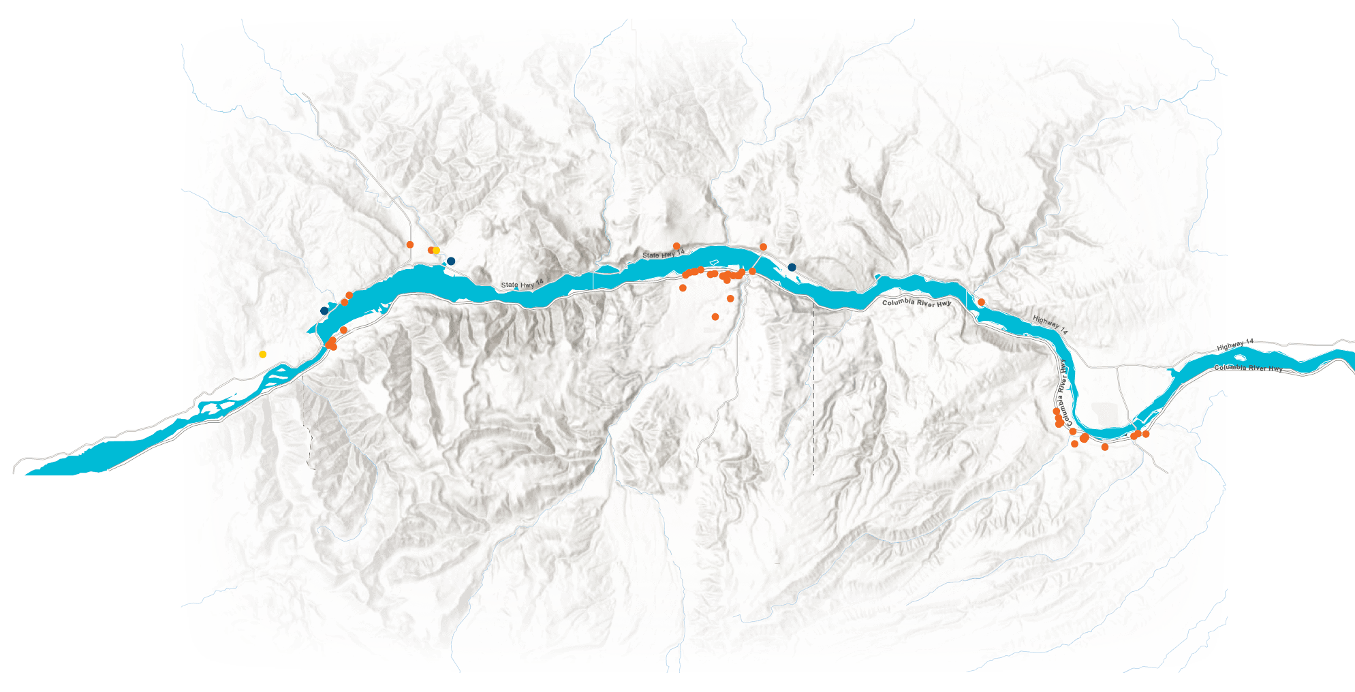
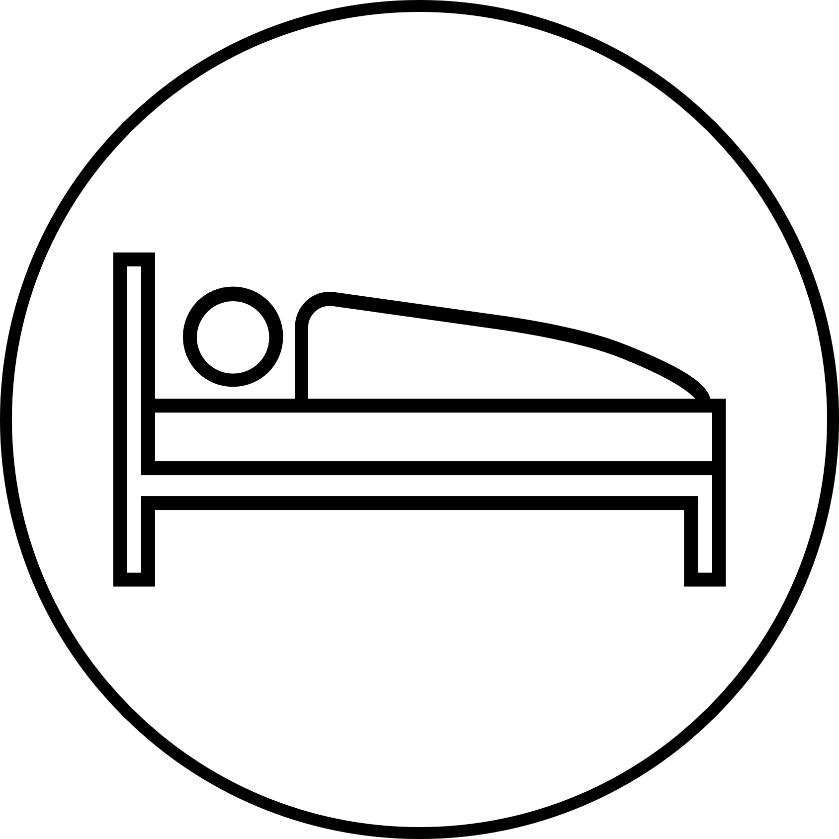
GORGE LODGING
Carson
White Salmon
48 Rooms
Carson
Hot Springs
22 Rooms
Stevenson
292 Rooms
North Bonneville
Hot Springs
Hood River
648 Rooms
Cascade Locks
120 Rooms
The Dalles
780 Rooms
47 existing lodging facilities
1,910 rooms
Washingtons side is underserved
39 lodging facilities (83%) on Oregon side
1,548 rooms (81%) on Oregon side
Hot Spring Properties
Resorts
Tenzen Springs- 8 rooms
Society Hotel- 34 rooms
Skamania Lodge- 254 rooms
Hotel/Motels
Notes:
Data from 2020 Study,
47 total lodging facilities
3 resorts
Tenzen Cabin and Spring about 8 cabins
Society Hotel about 34 rooms/hostel beds
Skamania Lodge is only larger scale resort with 254 rooms
Takeaways:
only one direct competitor wish similar scale to Hoshino- Skamania Lodge
Presence of Lodge and other boutique resorts demonstrates existing market (no occupancy data), but anecdotally the Skamania Lodge is frequently full in peak travel season
Aside from the opportunity properties that have existing water rights and are located in urbanized areas within the NSA, it would be difficult for a large hot spring resort to locate in the Gorge in the future (some protection from future competitors.
The North Bonneville/Carson area are one of the first areas with lodging opportunities that you reach on the Washington side. But there are few existing lodging facilities because most of the recent Hotel development has been in Oregon

Slide 7
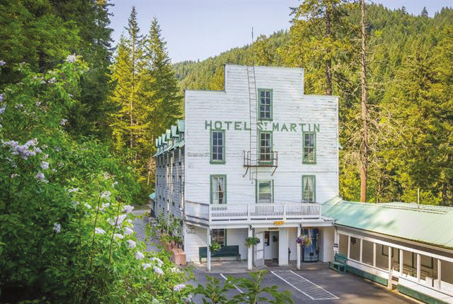
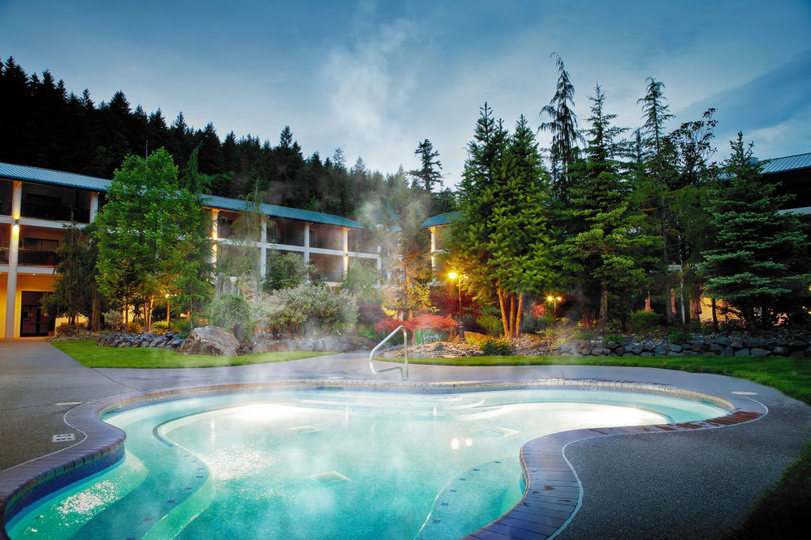
PROPERTY BENEFITS
Location in Gorge NSA
Existing water rights
Demonstrated demand for lodging
Local support
Carson Hot Springs
North Bonneville Hot Springs
Notes:
Located in urbanized area with the Gorge National scenic area means it does not have federal oversight from the Gorge Commission and Forest Service
Both properties have existing water rights that transfer with the sale of the property
Obtaining new rights through Ecology’s standard process can that 10-20 years, or 1-3 years and tens of thousands of dollars for expedited process.
There is demand for new lodging based on recent market studies in North Bonneville and Stevenson, WA
Recent planning efforts in North Bonneville and Stevenson have found that residents are interested in having additional lodging options

